Slide 1
Education
Team One
Sophia Chan, Sean Letzer, Stevanus Iskandar, Cassie Jeansonne

Slide 2
The Problem
Student Engagement
How do we get students to be more engaged in a large lecture hall ?
Due to the distance from the professor, students tend to be easily distracted by technology, friends, other class work, or social media.
Students are busy managing many other tasks and lack motivation to stay focused when attending lectures.
We have technology, to distract students from being distracted from their technology!

Slide 3
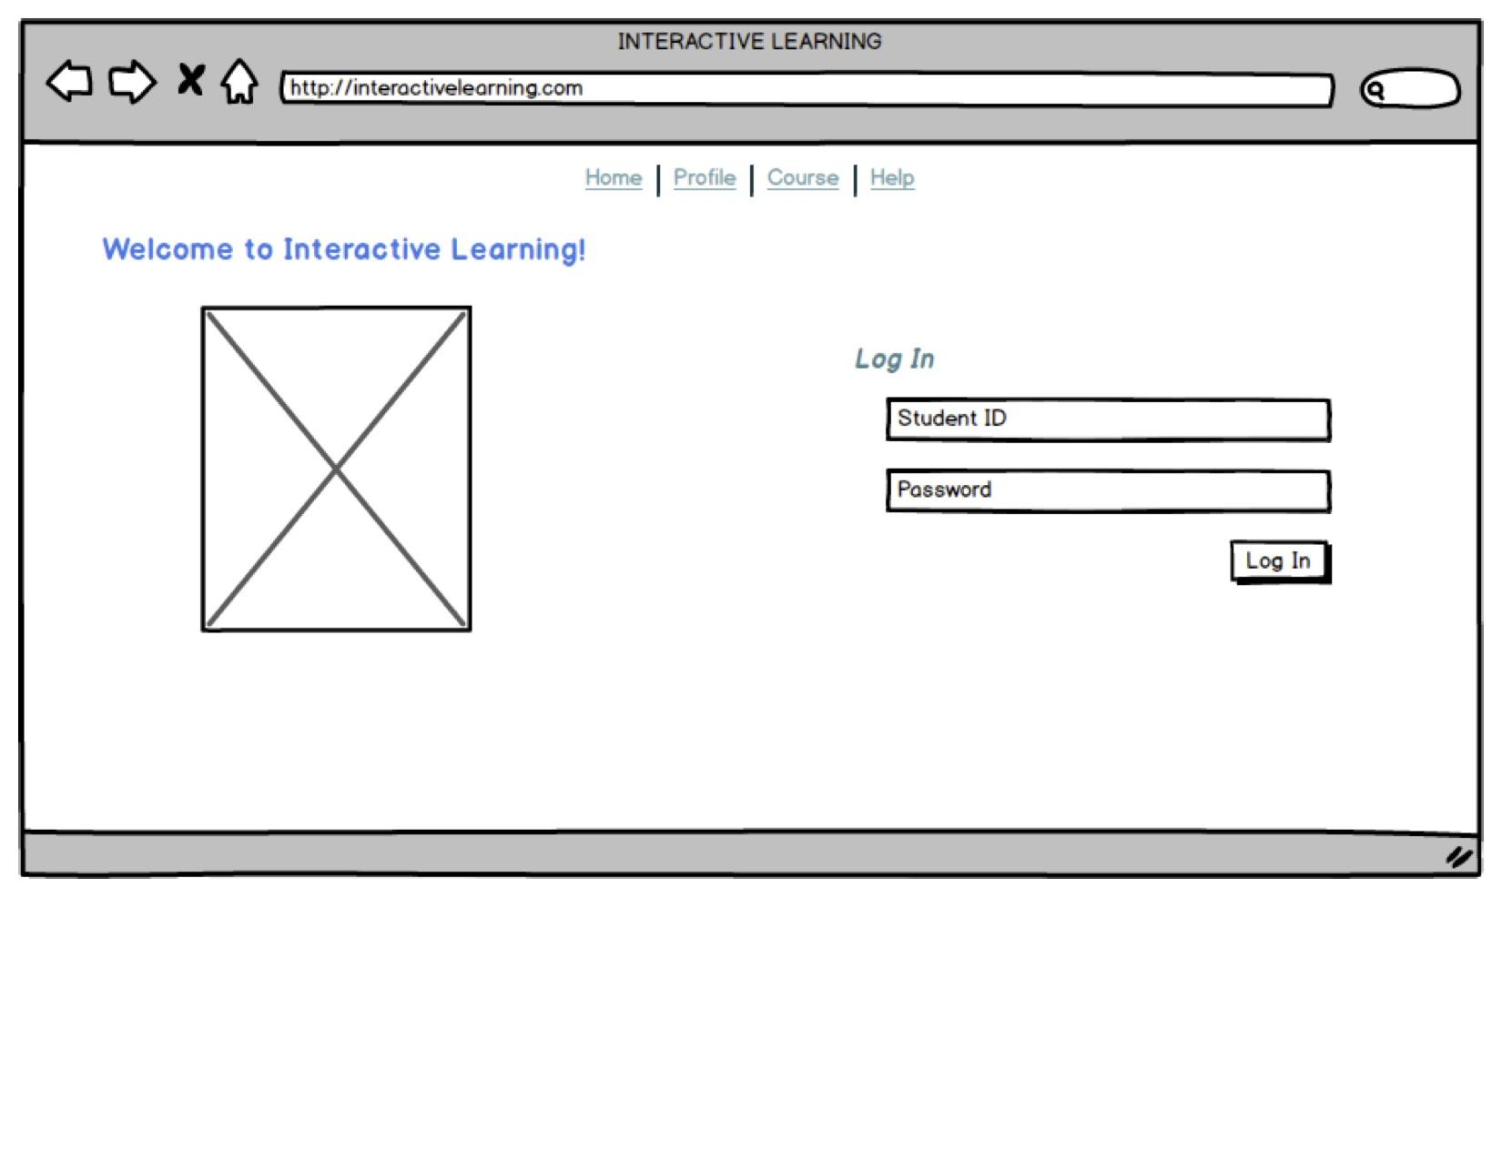
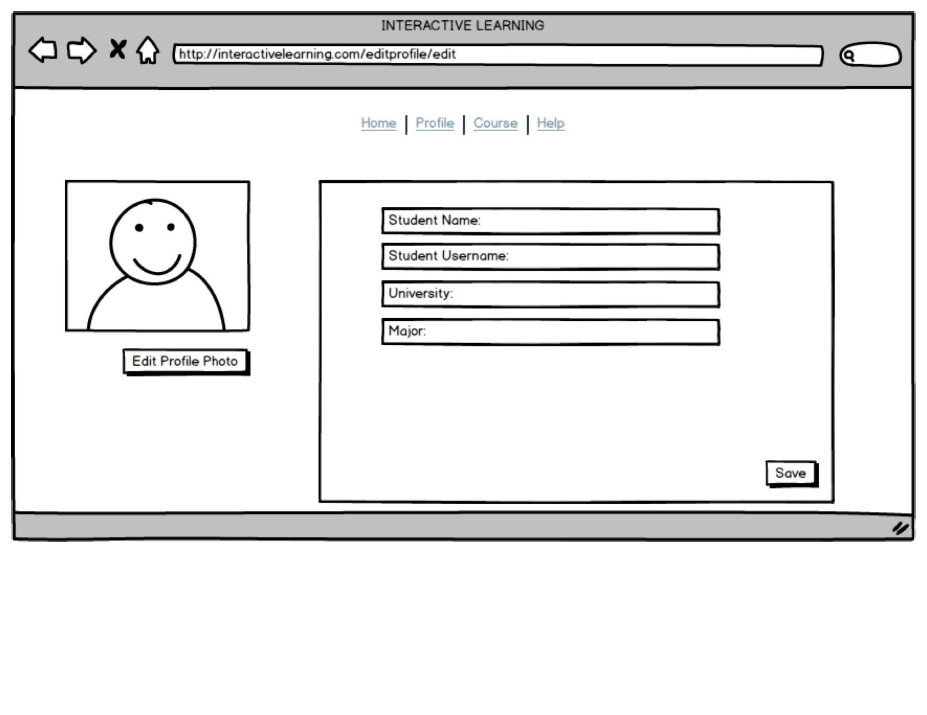
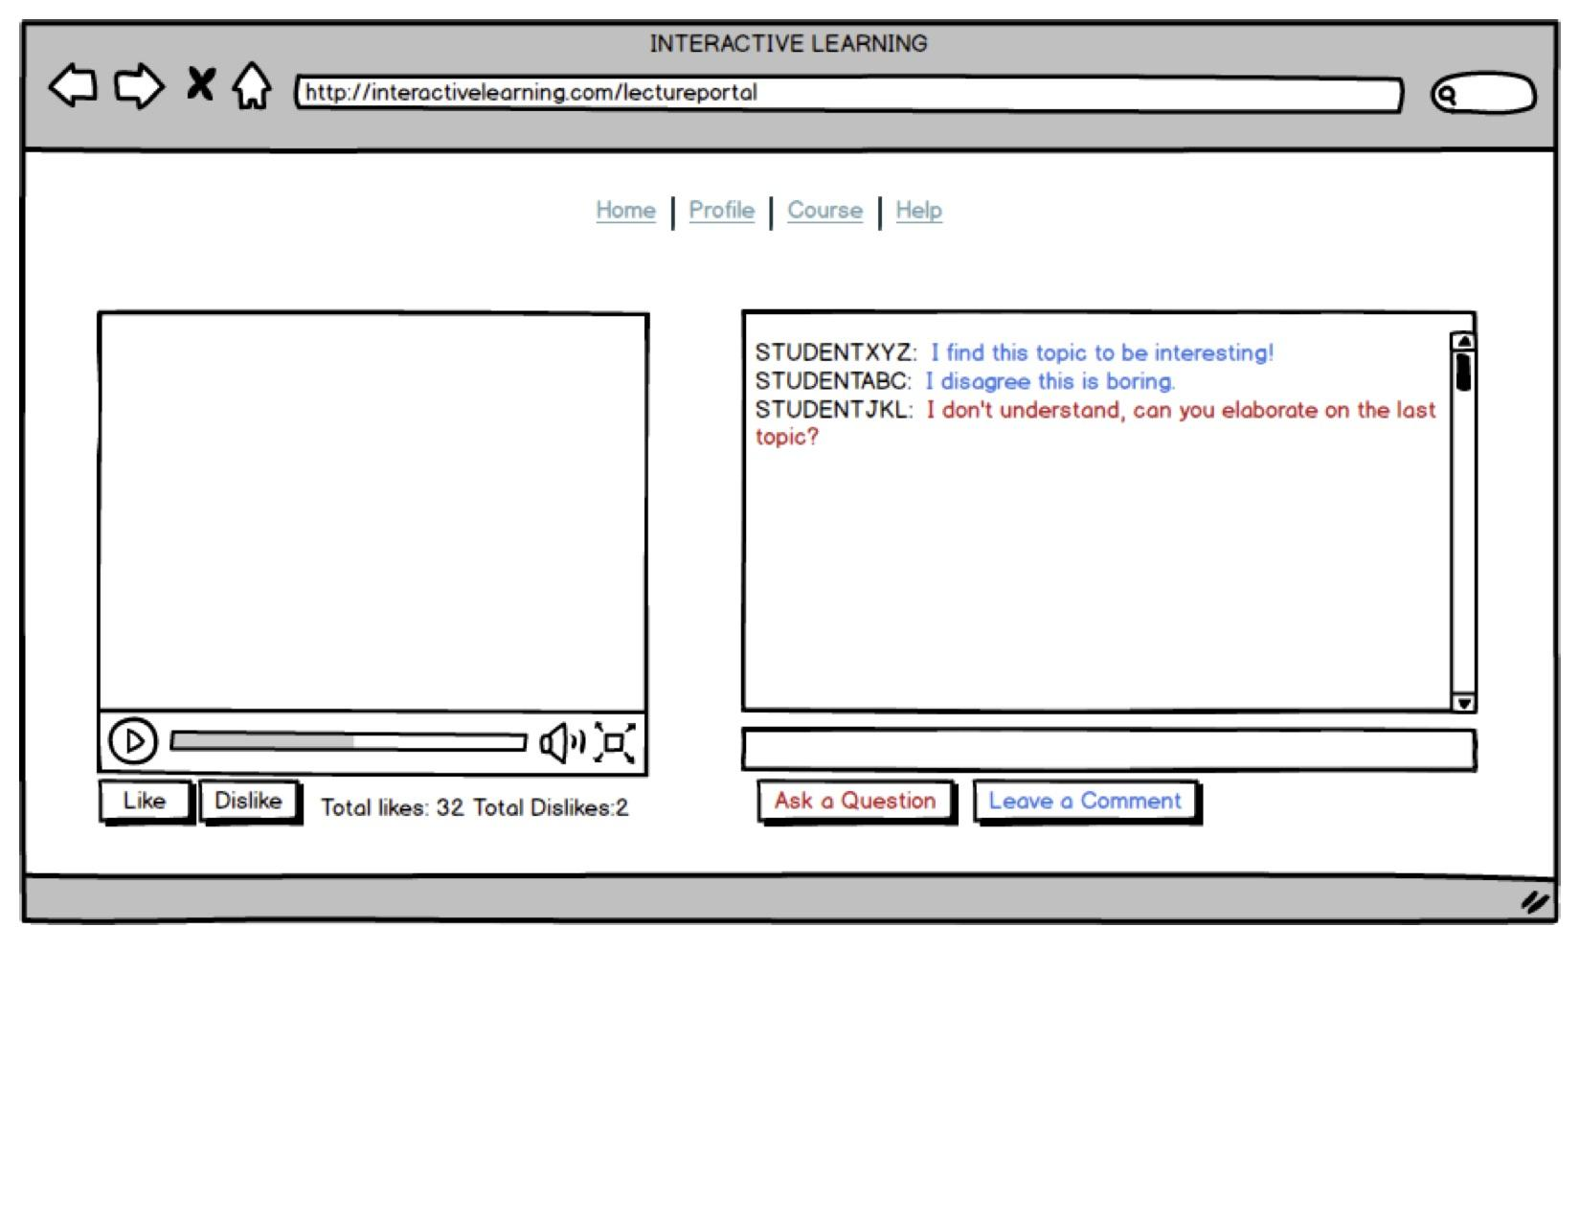
Prototype
Interactive Prototype Link

Slide 4
What we Learned?
It takes a lot of research and brainstorming about a problem before you can start the actual designing of the system.
When addressing a problem, sometimes taking in a part of the problem and finding a way to incorporate it into your solution can sometimes be the best way to address the issue.
For our problem technology was distracting students, so we decided to incorporate technology into our solutions and to find a way to have the technology become the reason students stay engaged.
User testing is key to discovering flaws with your system.
It often takes several iterations to work out a usable prototype.

Slide 5
What’s Next?
Collect feedback from THINK ALOUD sessions and make changes based on that feedback
Create a user interface for the professors to access
Prototype the professor’s user interface
Collect feedback and make changes to that system
Create a rough version of the real system
More User Testing!

Slide 6
Thank You!

